Slide 1

Metal 3D Printer
Initial Testing Results
Nathan Krikawa, Nolan Hann

Slide 2

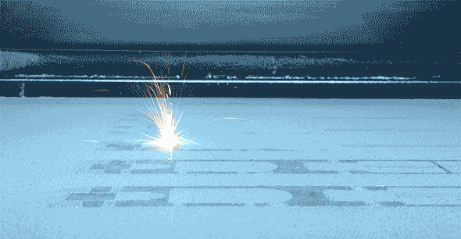
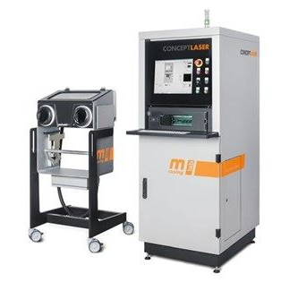
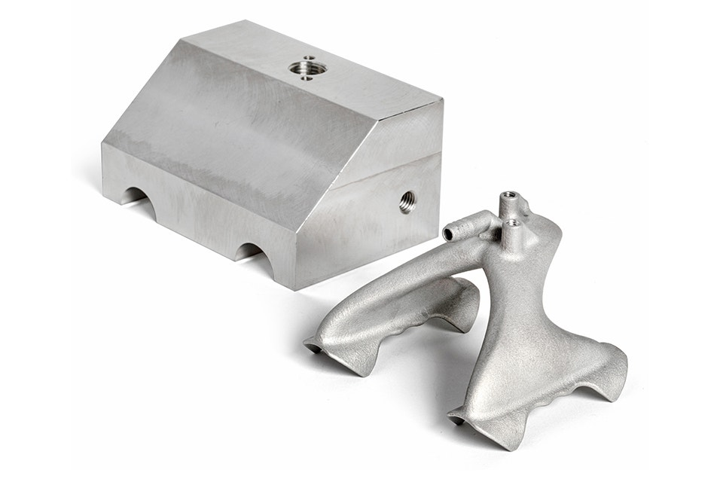
Project Description
Overview:
Commissioning of Concept Laser Mlab Cusing R metal 3D printer
Donated by Honeywell to NAU’s ME department for the IDEA Lab
Our Job:
Install and restore printer to proper functionality.
Evaluate printed specimen against machined counterparts
Print final part as part of assembly using topology optimization
Create instruction manual for training purposes in preparation for work orders and ME286L curriculum expansion
Figure 2: Selective laser melting
Figure 1: Concept Laser Mlab Cusing R
Figure 3: Redesigned aluminum gripper
Notes:
Overview:
Installing and Troubleshooting a M100LabR Concept Laser PBF Printer
Printing and evaluating parts and specimens (ie Stress-Strain, Thermal Management)
Creation of a user manual and short curriculum for ME286L
Included is the printer itself, powder mixer, powder trolley, and various powdered alloys for use with the printer
Location of set-up: CEIAS IDEA Lab, Room 116A

Slide 3
Design Requirement Summary
Engineering Requirements
Customer Requirements
# | Requirement | Units | Targets
ER1 | Materials Tested | Al, SS 316L, Ti, Bronze | One
ER2 | Final Print Material | Al, SS 316L, Ti, Bronze | SS 316L
ER3 | Final Print Volume | mm^3 | <90x90x80
ER4 | Power | V, A | 240V, 16A
ER5 | Inert Gas | N, Ar, bar, purity | 2 bar Ar purity >=2.5
ER6 | Young's Modulus Tested | GPa | 193
ER7 | Dog Bone Size | mm | 65
ER8 | Airtight Gas Supply | N/A | No audible leak
ER9 | Build Plate Alignment | N/A | Even material distribution
ER10 | Printed Part Tolerance | mm | ±0.2mm
# | Requirement | Description
CR1 | Ease of Use | Easily accessible to IDEA Lab managers, Instruction manual and supplementary instructions at hand
CR2 | Safety | Printer fully and properly installed, safety signs posted, PPE available, instruction manual at hand
CR3 | Time | Fully installed by the end of the spring 2025 semester
CR4 | Successful Installation | Printer fully operational, all technical issues addressed
CR5 | Tensile Test Results | All test specimen tested; all results analyzed
CR6 | Final Part and Assembly | Final part printed and assembled into greater assembly
CR7 | Instruction Manual | “First print” instruction manual complete with comprehensive steps and files attached
Notes:
Overview:
Installing and Troubleshooting a M100LabR Concept Laser PBF Printer
Printing and evaluating parts and specimens (ie Stress-Strain, Thermal Management)
Creation of a user manual and short curriculum for ME286L
Included is the printer itself, powder mixer, powder trolley, and various powdered alloys for use with the printer
Location of set-up: CEIAS IDEA Lab, Room 116A

Slide 4
Top Level Testing Summary
Test Summary Table
EXP1 – Test Print
Gas Leak Test
Build Module Trials
Shim Alignment
Test Print and Tolerance
EXP2 – Tensile Test
Tensile test machined specimen alongside printed specimen and compare
Experiment/Test | Relevant DRs | Testing Equipment Needed | Other Resources
EXP1 - Test Print | ER2 - Final Print Material (SS 316L) ER4 - Power ER5 - Inert Gas ER8 - Airtight Gas Supply ER9 - Build Plate Alignment ER10 - Printed Part Tolerance (±0.2mm) CR2 - Safety CR4 - Successful Installation CR6 - Final Part and Assembly CR3 - Time | Small tube Dial gauge indicator Shim Calipers | Rail system to slide dial gauge indicator along build module
EXP2 - Tensile Test | ER2 - Final Print Material (SS 316L) ER6 - Young's Modulus Tested ER7 - Dog Bone Size CR5 - Tensile Test Results CR3 - Time | Tensile test equipment Calipers
Notes:
Overview:
Installing and Troubleshooting a M100LabR Concept Laser PBF Printer
Printing and evaluating parts and specimens (ie Stress-Strain, Thermal Management)
Creation of a user manual and short curriculum for ME286L
Included is the printer itself, powder mixer, powder trolley, and various powdered alloys for use with the printer
Location of set-up: CEIAS IDEA Lab, Room 116A

Slide 5
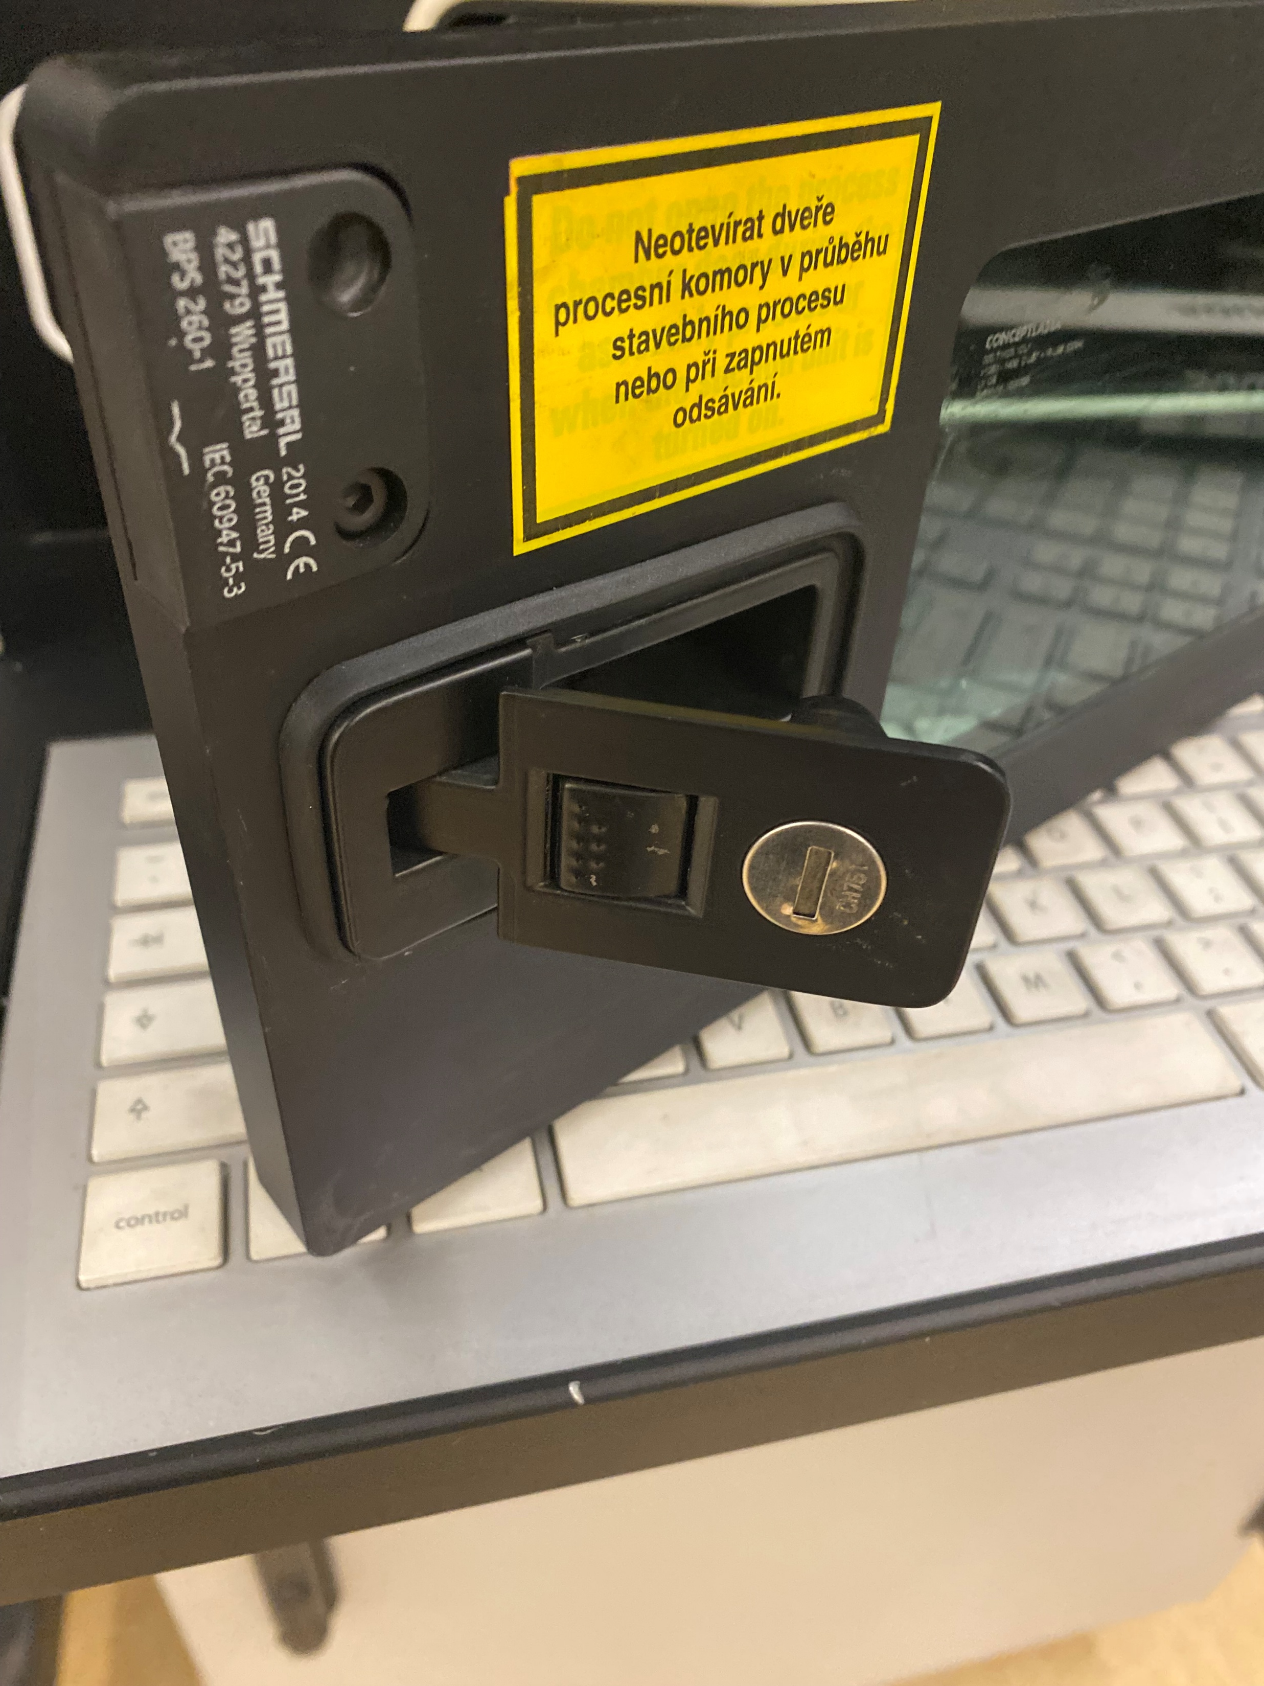
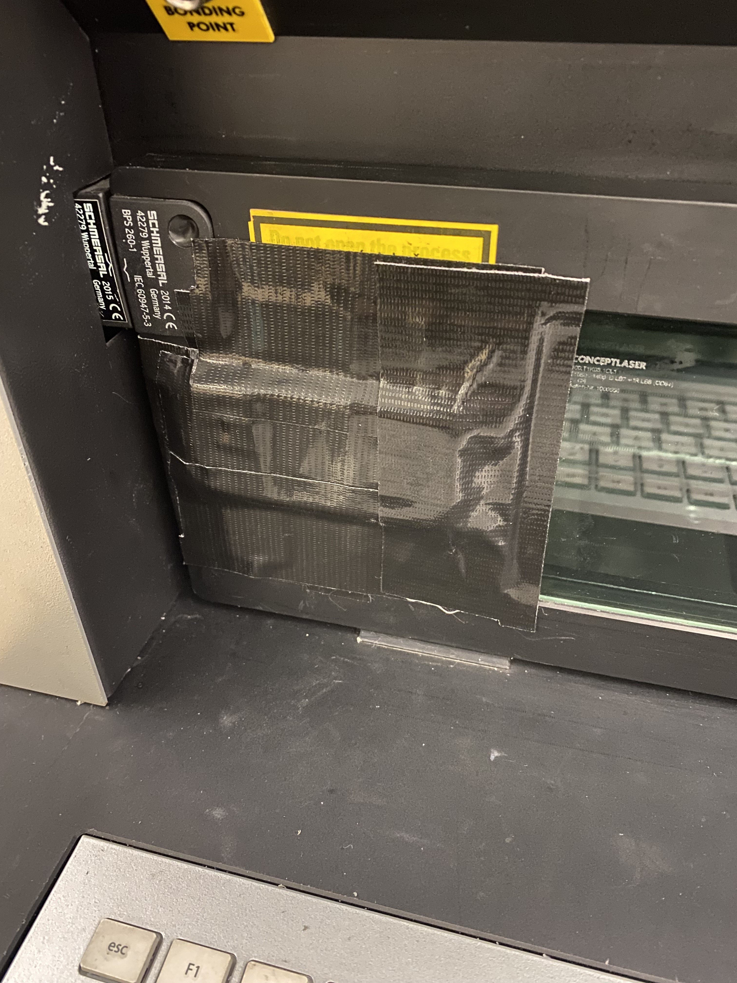
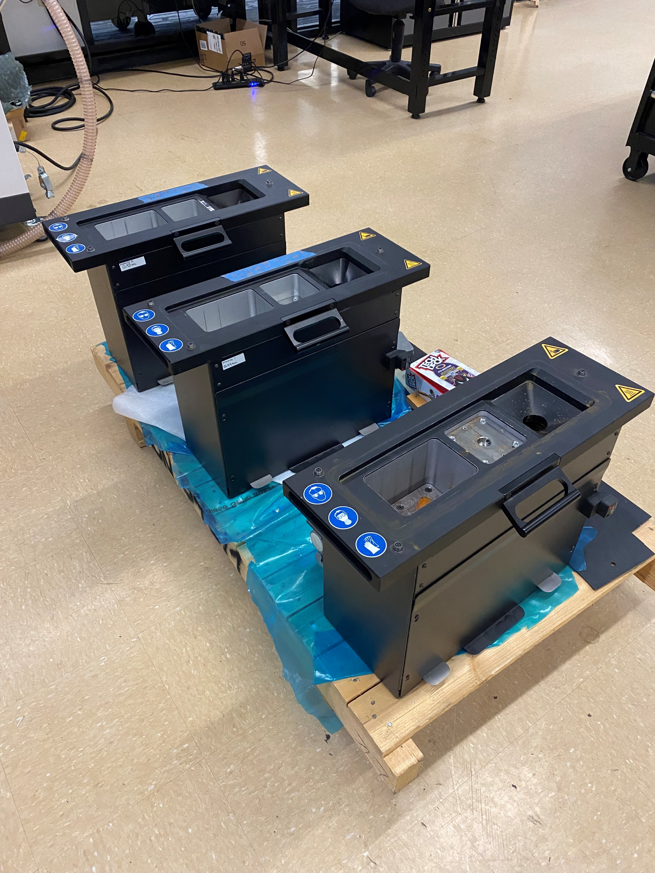
Detailed Testing Plans
EXP1 – Test Print
EXP1.1 – Gas Leak Test (50%)
Using 1” copper tube to detect audible leakage around gas tank, supply hose, and build chamber door.
EXP1.2 – Build Module Trials (100%)
Testing remaining 4 build modules for operation and alignment.
Figure 4: Door Seal Latch
Figure 5: Duct Taped Door Seal Latch
Figure 6: Build Modules
Notes:
Overview:
Installing and Troubleshooting a M100LabR Concept Laser PBF Printer
Printing and evaluating parts and specimens (ie Stress-Strain, Thermal Management)
Creation of a user manual and short curriculum for ME286L
Included is the printer itself, powder mixer, powder trolley, and various powdered alloys for use with the printer
Location of set-up: CEIAS IDEA Lab, Room 116A

Slide 6
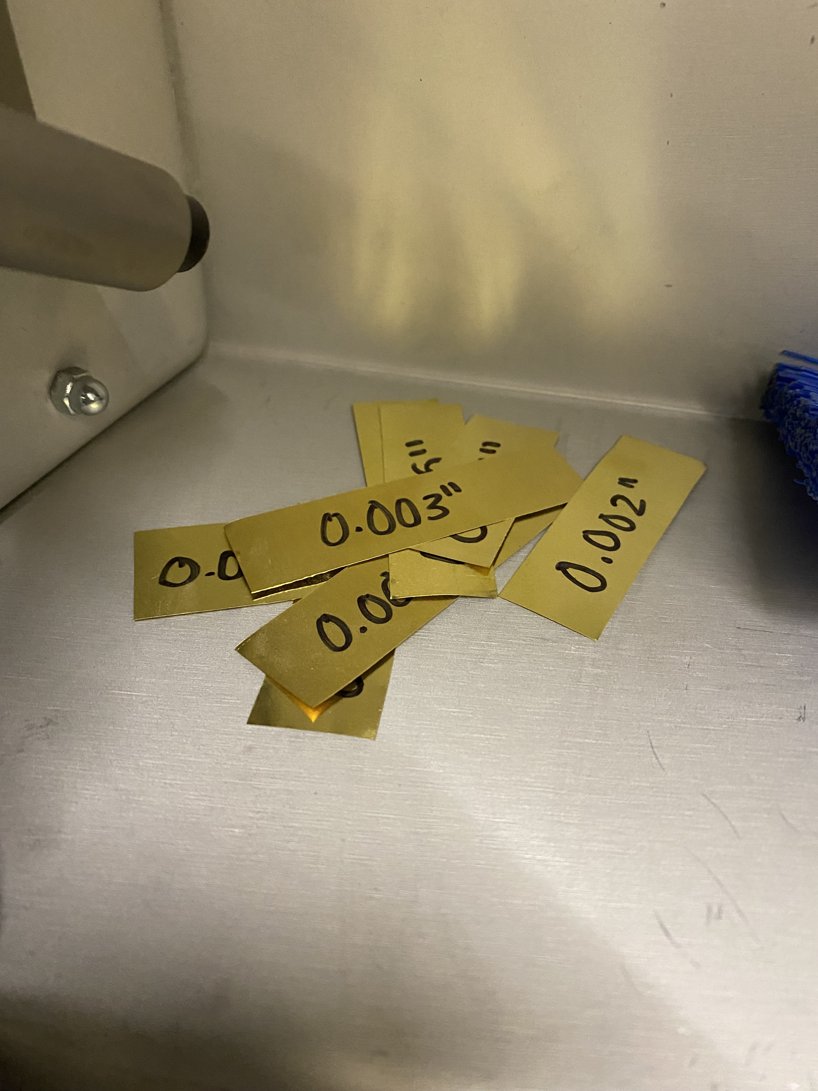
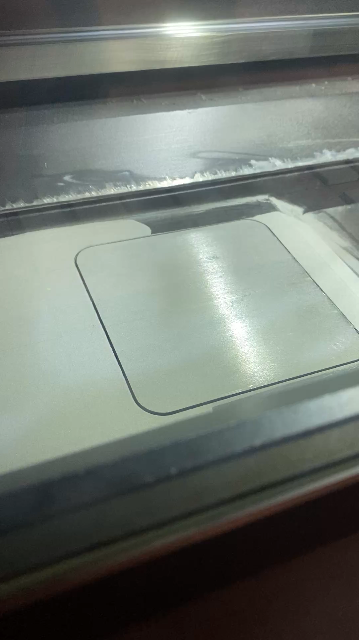
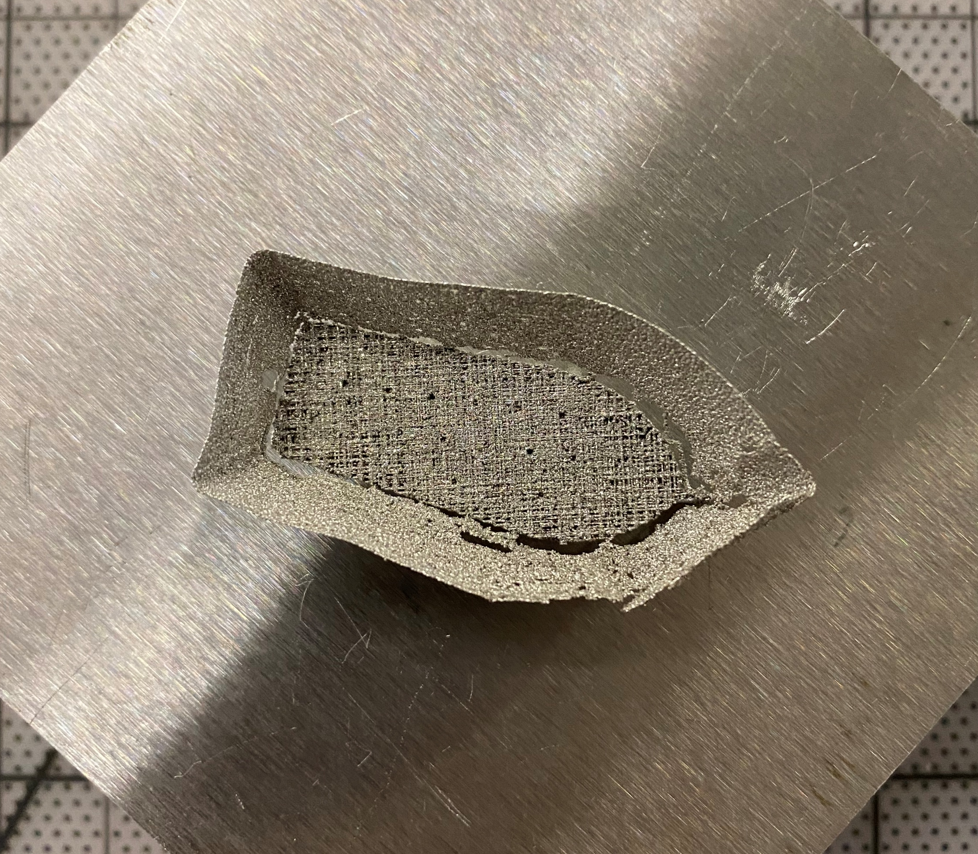
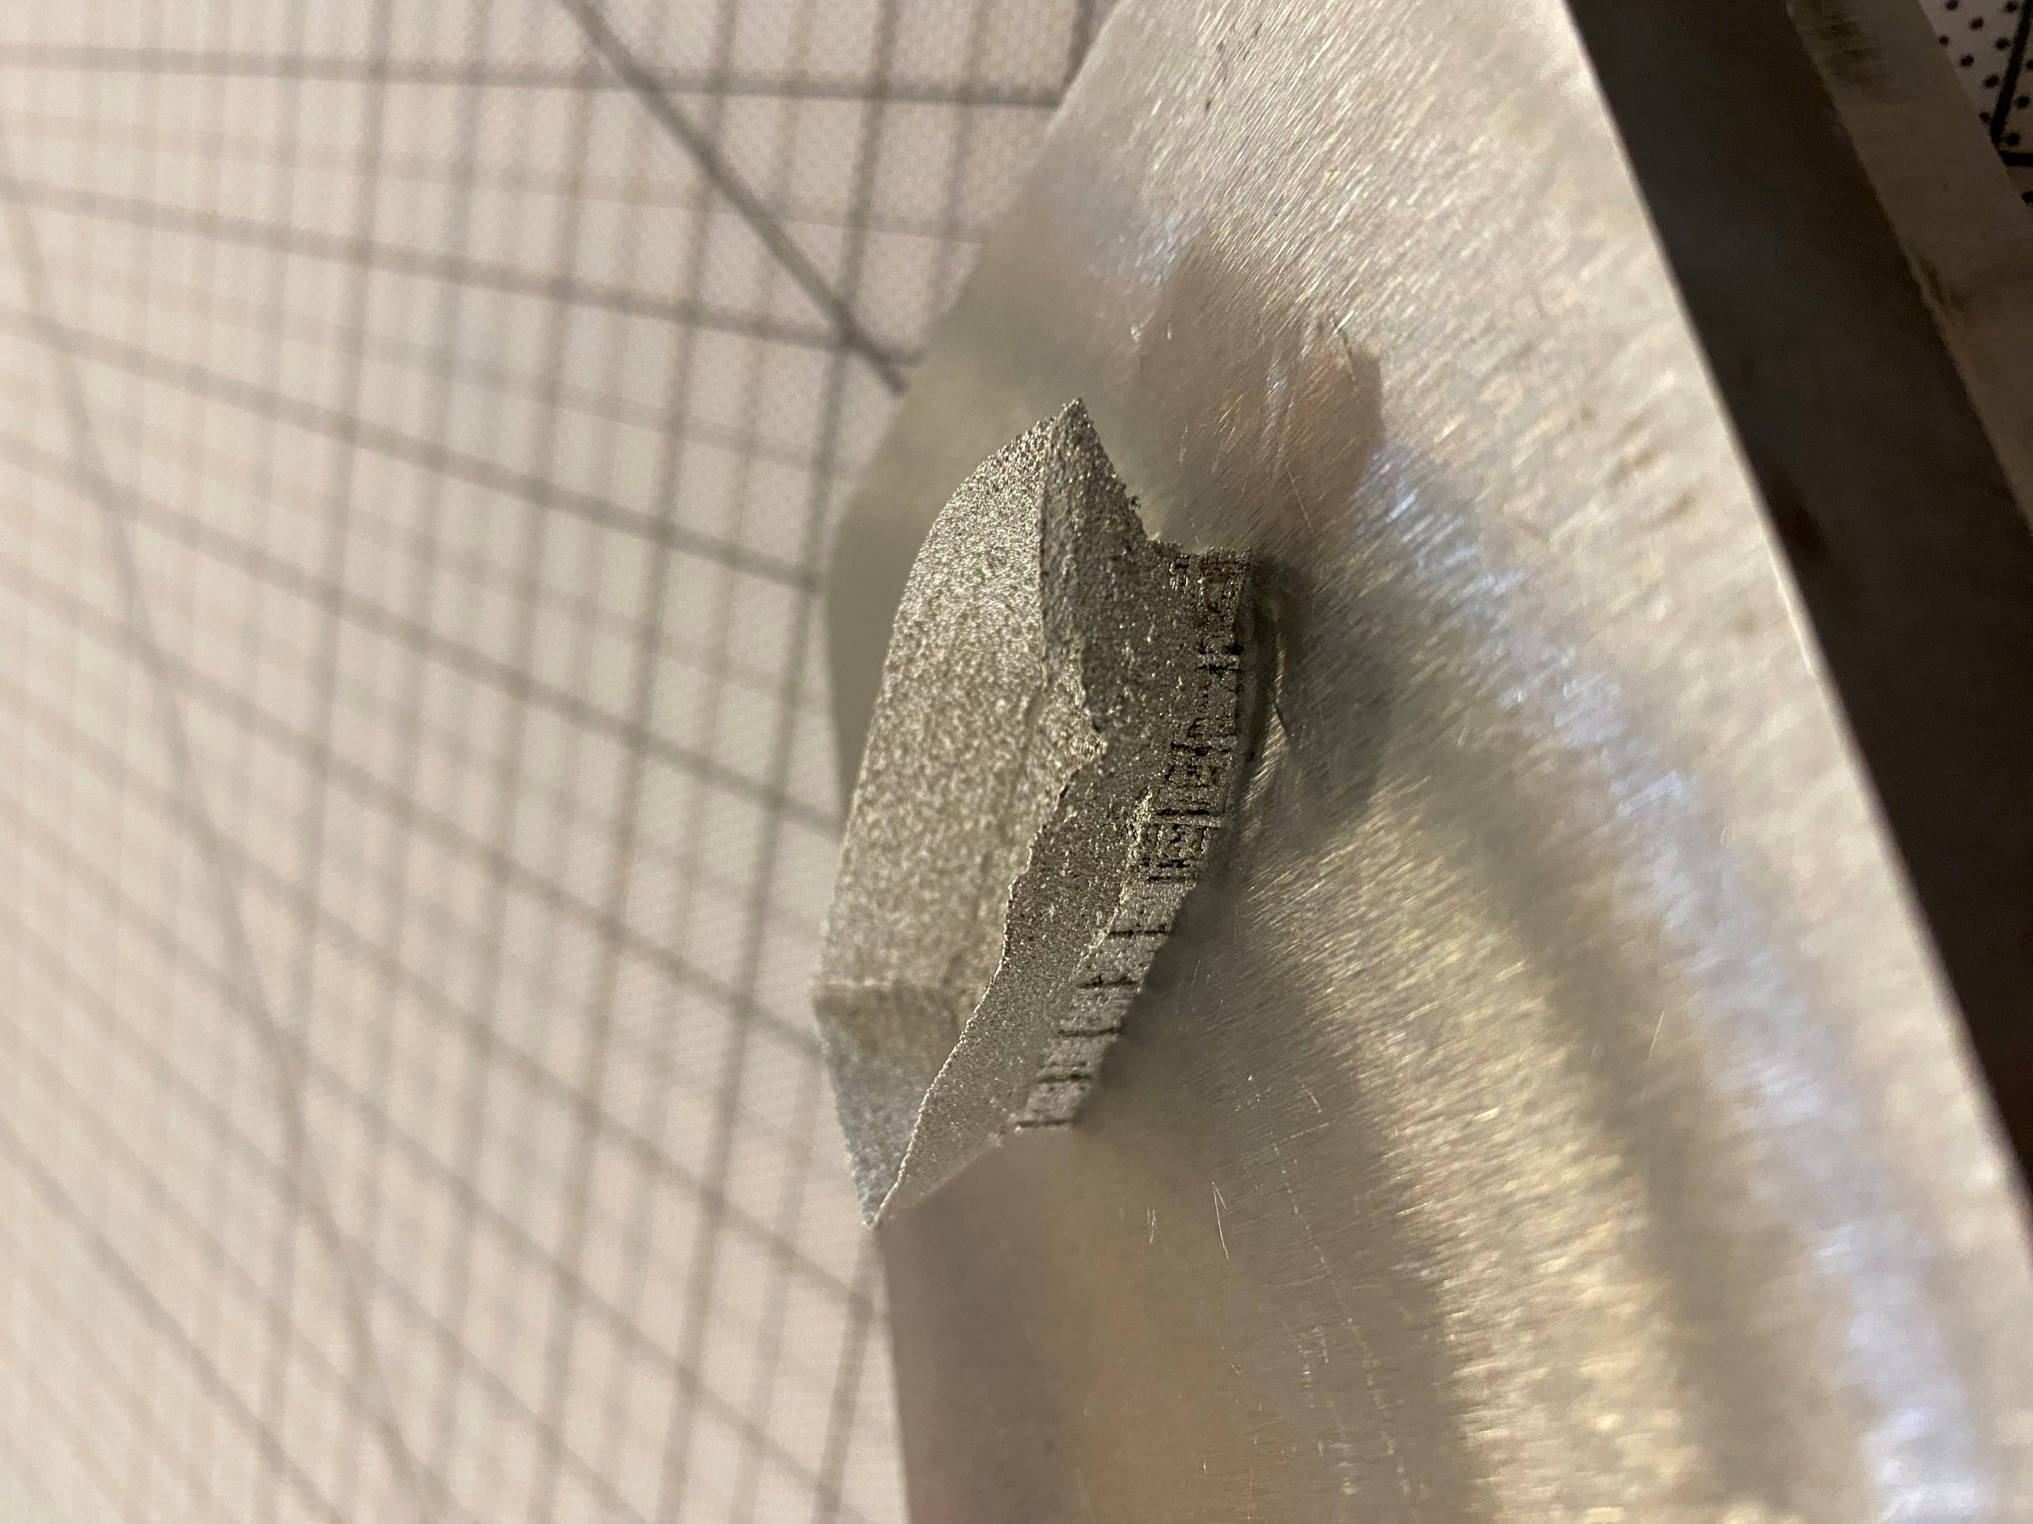
Detailed Testing Plans
EXP1 – Test Print
EXP1.3 – Shim Alignment (100%)
Leveling build plate using brass shims between build plate and build chamber
EXP1.4 – Test Print and Tolerance (20%)
Print complete part and test dimensions for tolerance ±0.2mm
Figure 7: Test Shims
Figures 8 & 9: Benchy Print
Figure 10: Level Build Plate
Notes:
Overview:
Installing and Troubleshooting a M100LabR Concept Laser PBF Printer
Printing and evaluating parts and specimens (ie Stress-Strain, Thermal Management)
Creation of a user manual and short curriculum for ME286L
Included is the printer itself, powder mixer, powder trolley, and various powdered alloys for use with the printer
Location of set-up: CEIAS IDEA Lab, Room 116A

Slide 7
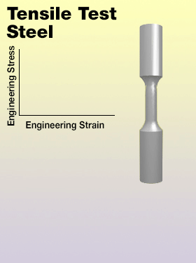
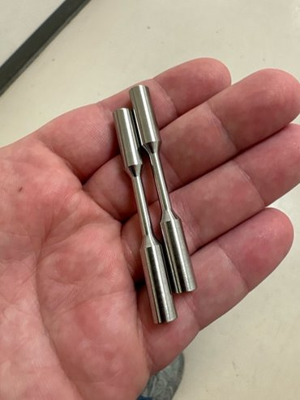
Detailed Testing Plans
EXP2 – Tensile Test
EXP2 – Tensile Test (15%)
Tensile test specimen are placed in the device, then are slowly strained using increasing force until failure.
EXP2.1 (30%)
Machined specimens tested in room 110, tensile testing following E8/E8M and results graphed.
EXP2.2 (0%)
Printed specimen tested in room 110, similarly following E8/E8M and results graphed.
Figure 11: Testing Animation
Figure 12: Machined Specimen
Notes:
Overview:
Installing and Troubleshooting a M100LabR Concept Laser PBF Printer
Printing and evaluating parts and specimens (ie Stress-Strain, Thermal Management)
Creation of a user manual and short curriculum for ME286L
Included is the printer itself, powder mixer, powder trolley, and various powdered alloys for use with the printer
Location of set-up: CEIAS IDEA Lab, Room 116A

Slide 8
Specification Sheets
ER Summary Table
CR Summary Table
Engineering Requirement | Target | Tolerance | Measured/Calculated Value | ER met? (Yes or No) | Client Acceptable (Yes or No)
Materials Tested | One | N/A | One | Y | Y
Final Print Material | SS 316L | N/A | SS 316L | Y | Y
Final Print Volume | <90x90x80 | No Tolerance | <90x90x80 | Y | Y
Power | 240V, 16A | >=240V | 240V, 16A | Y | Y
Inert Gas | 2 bar Ar purity >=2.5 | No Tolerance | 2 bar Ar purity >=2.5 | Y | Y
Young's Modulus Tested | 193 | N/A
Dog Bone Size | 65 | +-0.1mm
Airtight Gas Supply | No audible leak | No Tolerance | No audible leak | Y | TBD
Build Plate Alignment | Even material distribution | No Tolerance | Even material distribution | Y | TBD
Printed Part Tolerance | ±0.2mm | Same as Target
Customer Requirement | CR Met? (Yes or No) | Client Acceptable (Yes or No)
Ease of Use | Y | Y
Safety | Y | Y
Time | Y | TBD
Successful Installation | Y | TBD
Tensile Test Results | Y | Y
Final Part and Assembly | N | TBD
Instruction Manual | N | TBD
Notes:
Overview:
Installing and Troubleshooting a M100LabR Concept Laser PBF Printer
Printing and evaluating parts and specimens (ie Stress-Strain, Thermal Management)
Creation of a user manual and short curriculum for ME286L
Included is the printer itself, powder mixer, powder trolley, and various powdered alloys for use with the printer
Location of set-up: CEIAS IDEA Lab, Room 116A

Slide 9
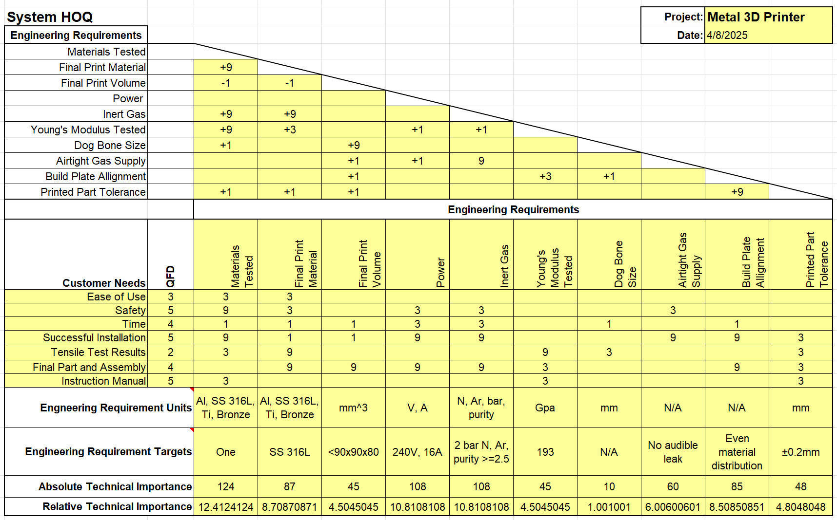
QFD
Notes:
Overview:
Installing and Troubleshooting a M100LabR Concept Laser PBF Printer
Printing and evaluating parts and specimens (ie Stress-Strain, Thermal Management)
Creation of a user manual and short curriculum for ME286L
Included is the printer itself, powder mixer, powder trolley, and various powdered alloys for use with the printer
Location of set-up: CEIAS IDEA Lab, Room 116A

Slide 10

Thank You!
Any Questions?

